Slide 1
Year 6
Place Value
To know how to read and write numbers to 10,000,000

Slide 2
Summary
Key Vocabulary and Sentence Stems
Diagnostic Question
Learning Objective
Starter – Match the numbers and representations
Let’s Learn
Follow Me – Place value chart to write numbers
Your Turn (1) – Place value chart to write numbers
Follow Me – Writing numbers in numerals
Your Turn (2) – Writing numbers in numerals
Follow Me – Identify the mistake
Your Turn (3) – Making and writing numbers
Let’s Reflect
Support Slides – Based on identifying the value of digits in a number

Slide 3
Key Vocabulary
words | numerals
millions | comma
digit
Sentence Stems
There are (digit) thousand(s), (digit) hundred(s), (digit) ten(s) and (digit) one(s). The number is (total).
There are 2 thousands, 5 hundreds, 3 tens and 9 ones. The number is 2,539.
This can be adapted for numbers in the millions.

Slide 4
What is this number in numerals?
Three million, two hundred and fifty-nine thousand, eight hundred and twelve
8,2059,8012
3,259,820
3,259,812
3,000,000
259,000
812
Notes:
Assessment point for the lesson – ask the pupils to vote for the answer they think is correct.
A – The pupil has included a zero to represent ‘and’ .
B – The pupil has misread 12 as 20.
C – Correct answer.
D – While the parts are correct, this is one number, not three. The pupil may not understand how to write this as one number.

Slide 5
To read and write numbers to 10,000,000

Slide 6
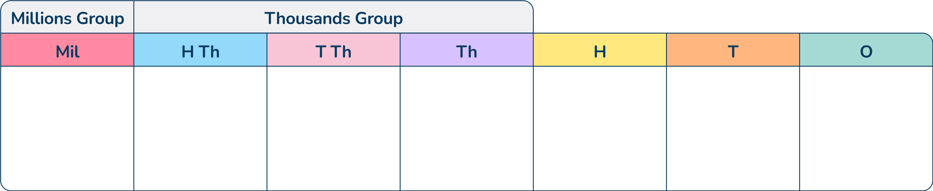

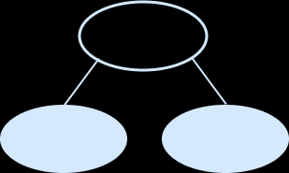
Starter
Match the number to the representation.
4,631,893
89,025,727
89,000,727
25,000
Four million, six hundred and thirty-one thousand, eight hundred and ninety-three
2,057,164
Explain how you know which representation and number match.
Answers
Notes:
Key Questions – What does the x digit represent? How do you know? What would happen if I swapped these two digits? What is the importance of the 0?
Further Practice – Provide pupils with more numbers, and representations to match together or pairs of pupils create a list of three number and three representations for their partner to match.
Extension – How many ways can you represent one number? Prove that you have found all the representations.

Slide 7
Let’s Learn
We need to think carefully about how we say larger numbers out loud.
2
7
8
5
4
3
6
We say this number as two million, seven hundred and eighty-five thousand, four hundred and thirty-six.
‘and’ isn’t used between every number.
When writing larger numbers, we use commas as separators to help read the number.
Notes:
Use this slide to discuss the structure of larger numbers and when commas/ ands are used in a number. Numbers are grouped into threes with commas separating the groups of threes.
Concrete resources – Place value chart
Key Questions – How do you say this out loud? How do you write this? Where do you put the commas? Where do you write ands? How do you know?

Slide 8

Follow Me
Lola has made this number in the place value chart.
Write Lola’s number in numerals and words.
4,231,005
Four million, two hundred and thirty-one thousand and five.
Answers
Notes:
Concrete resources – Place value chart, counters
Key Questions – What do you notice about the hundreds/ tens columns? How do I write this word? Where do I put the commas? How do I say/ write this? Where do the ‘ands’ go?
Misconceptions/ Common Errors – Pupils may not know how to say numbers including place holders.
Further Practice – Create a different number using the place value chart/ counters and write the number using words and numerals.
Extension – Is this a good explanation of how to write the number in words? ‘Put and between hundreds and tens’.

Slide 9
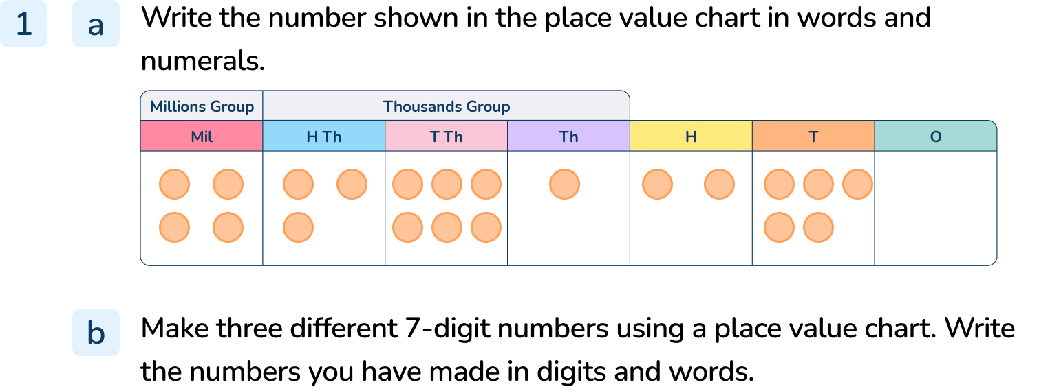
Your Turn
Notes:
4,361,250. four million, three hundred and sixty-one thousand, two hundred and fifty.
Answers will vary.

Slide 10
Follow Me
Write these numbers in numerals.
500,000
Half a million
2,850,027
Two million, eight hundred and fifty thousand and twenty-seven
2,872,500
Two million, eight hundred and seventy-two thousand, five hundred
2,200,875
Two million, two hundred thousand, eight hundred and seventy-five
Answers
Notes:
Concrete resources – Place value charts and counters, Gattegno charts
Key Questions – These numbers involve place holders, where do they go? What is half a million in numerals? What do you notice about the numbers (after half a million)?
Misconceptions/ Common Errors – Pupils may find the inclusion of place holders difficult.

Slide 11
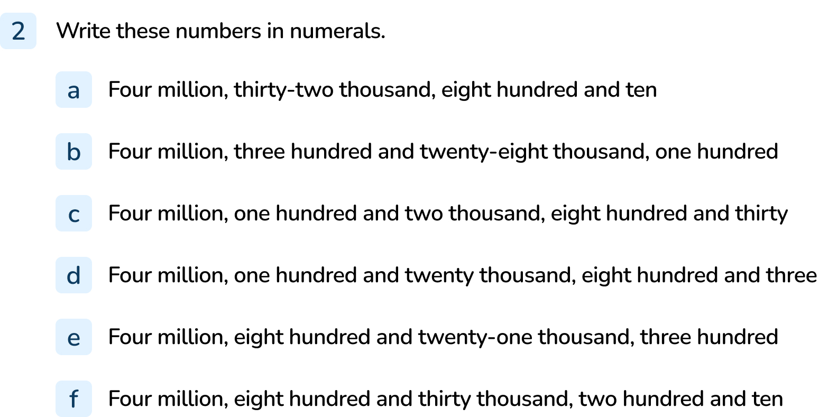
Your Turn
Notes:
4,032,810
4,328,100
4,102,830
4,120,803
4,821,300
4,830,210

Slide 12
Follow Me
Simon has these digit cards.
He says, “The largest number I can make is nine million and seven hundred and fifty-four thousand and one hundred and twenty.”
Do you agree?
7
5
0
2
4
1
9
Simon is right that this is the largest number he can make (9,754,120) but this is not how you write the number. Instead it is written: nine million, seven hundred and fifty-four thousand, one hundred and twenty.
Answers
Notes:
Concrete resources – Digit cards
Key Questions – Is this the largest number he can make? Is this how you say/ write the number? What is wrong about the way Simon has written this number?
Misconceptions/ Common Errors – Pupils may not know where to put ‘and’, especially as they have looked at examples where there are place holders that seem to move the ‘and’s closer together.
Further Practice – What is the smallest number you can make? Write it in numerals and words.

Slide 13
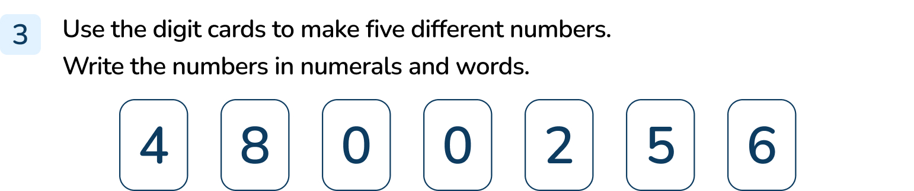
Your Turn
Notes:
Answers will vary depending on numbers created.

Slide 14
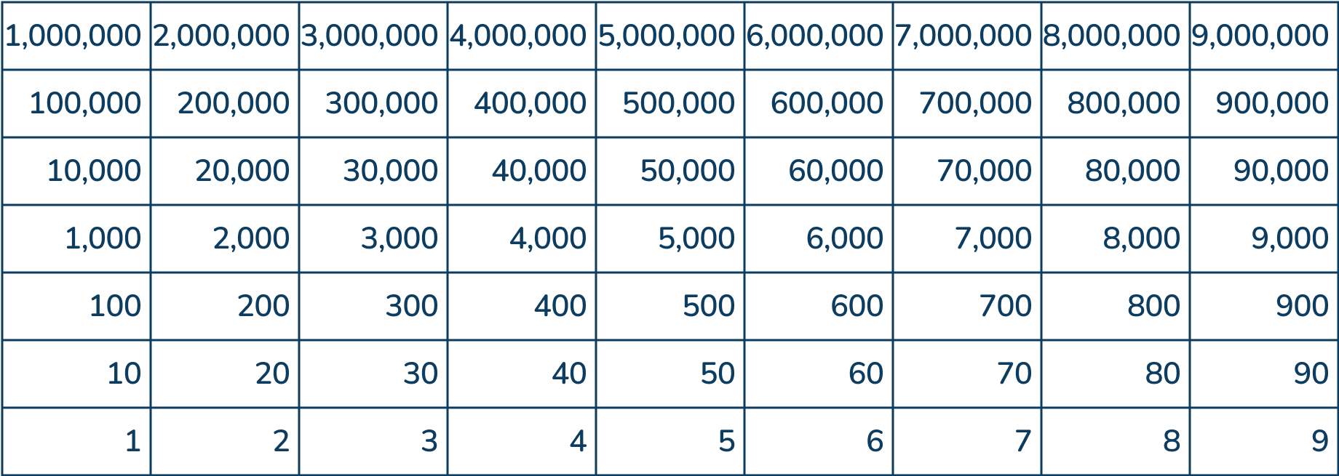
Let’s Reflect
Make 7-digit number for a partner using the Gattegno chart.
Can your partner write the number you have made in words and numerals?
Notes:
Concrete resources – Gattegno chart
Key Questions – Which number have you made? Where do you put ‘and’? Where do the commas go when you write the number in numerals? Did your partner get the same answers as you?
Misconceptions/ Common Errors – Pupils need to have the correct answer themselves to check their work with their partner, some may not have the correct answer themselves.

Slide 15
The following slides are based on:
Identifying the value of digits in a number

Slide 16
Write the value of the digit 5 in each number.
Use the place value chart to help you.
852,491
247,125
336,547
50,000
5
500
Answers
Notes:
How and when to use these slides – Pupils need to have a good understanding of the place value of each digit in a number in order to write the number accurately in words. Use these slides to recap the value of digits in a number (using place value charts and Gattegno charts as support).
Concrete resources – Place value chart, counters
Key Questions – What do I mean by ‘value’ of the digit? Which column is the digit 5 in in this number? How is this different to the other numbers? Why is the position of a digit within a number important?
Misconceptions/ Common Errors – Pupils may say they all have a value of 5.
Further Practice – Represent the numbers using different resources.

Slide 17

What number does the Gattegno chart show?
How does a Gattegno chart help you know the value of each digit in a number?
970,614
Answers
Notes:
Concrete resources – Gattegno chart
Key Questions – How many ones/ tens etc are there? How many thousands are there? How do I write this as in numerals? Do I always include the zeros? Which column needs a zero? Why?
Misconceptions/ Common Errors – Pupils may write 97,614 or include all the zeros.
Further Practice – Change the number and identify the value of each digit again. Encourage pupils to identify that the Gattegno chart shows the value of the digits.

